Slide 1

Short Term Trading on Texas Power Market: Pitchbook
Quantitative Trading Strategies (Winter 2025)
Pierre-Yves Sojic (12458566)
Timothee Maret (12269202)
Louis Otto (12275001)
Benjamin Gerino (12452987)

Slide 2

Pitchbook Structure
Trading Strategy–An Overview
US Power Market Explained
Why US Power Market
Why the Texas Power Market
Financial trading and available products
Exploratory Data Analysis: Price Dynamics
Congestion Trading
DART Trading
Inter-Hub Relationships
Gas Prices
Wind & Temperature
Load data
Trading strategies in the Power Market
Factors
Forecast Models
DART Premium
Spike Forecasts
Strategies implementation
Naive Strategies
Spike prediction strategy
Future Improvements
Appendix & Notebook

Slide 3
1. Trading Strategy–An Overview
The power market is compose of thousands of nodes in the US that have uniques prices. More, there several (auction) market depending on the delivery date (day-ahead and real-time for exemple). This creates a wide combination of possibilities for the traders. By the nature of this market, there are statistical arbitrage to be made both spatially (between nodes) and temporally. Being a commodity, tangible predictors are used to model prices
Our Objective:
Analyze historical LMP data (for many nodes, real-time and day-ahead) during the year 2024 along with demand (load) data, weather data, and natural gas data .
Infere DART spread using predictors (forecasted demand, gas prices, weather data).
Infere/Forecast spike prices
Implement a DART trading strategy.

Slide 4
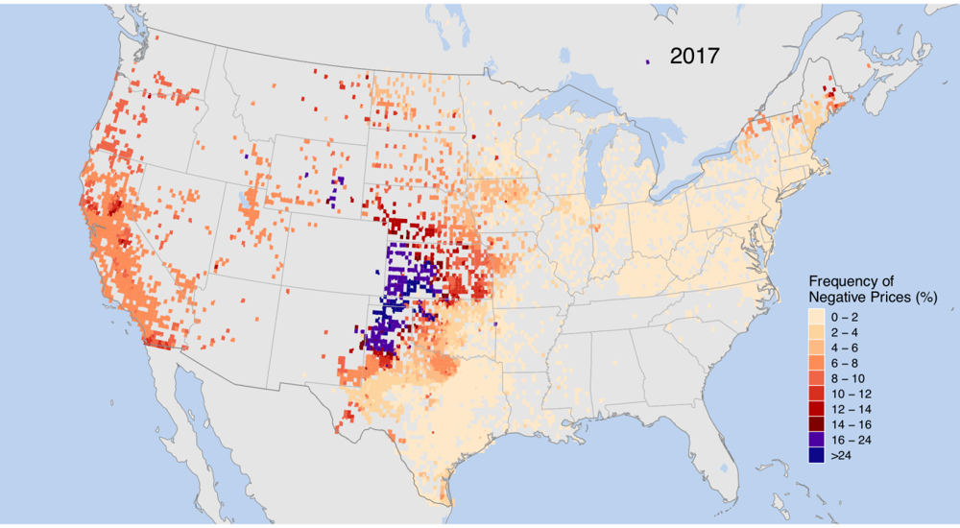
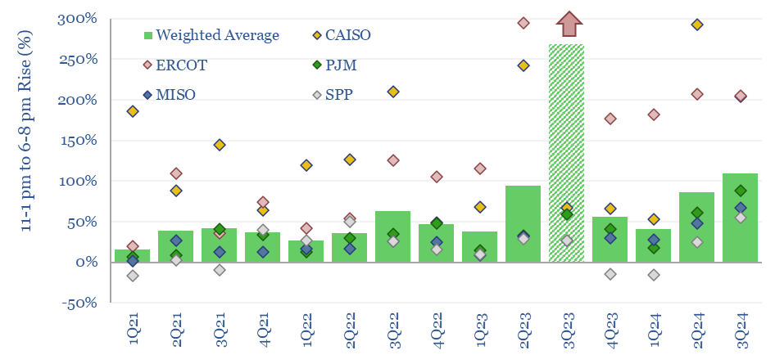
2. US Power Market Explained
Real-Time Balance Requirement:
Electricity cannot be stored economically in large quantities, so production and consumption must be balanced in real time to avoid blackouts.
Even small imbalances can cause large price swings.
High Volatility in Spot Prices:
Power grids require instant balancing; generators have different costs and flexibilities, resulting in extremely volatile spot prices.
Prices can spike or crash within minutes, with volatility up to two orders of magnitude higher than other commodities.
The day-ahead market is a way for generators/retailers to hedge and let the traders take the risk (DART spread)
Impact of Renewables:
The rise of wind and solar introduces large, rapid supply fluctuations.
Surplus power can drive prices to zero or negative, while sudden drops in renewable output lead to scarcity and price spikes.
Negative wholesale prices are now common in markets with high renewables, as generators pay to stay online during oversupply.
Intra-day Arbitrage Opportunities:
Rising intra-day price volatility creates lucrative arbitrage windows.
In some U.S. regions (e.g., CAISO, ERCOT), evening peak prices (6–8 pm) exceed midday prices (11 am–1 pm) by over 100%.
This trend highlights increasing price spreads that quantitative strategies can exploit.
Notes:
Sources:
[1]https://en.wikipedia.org/wiki/Electricity_price_forecasting#:~:text=Extreme%20price%20volatility%2C%20which%20can,A%20ballpark%20estimate%20of
[2]https://www.energy.gov/eere/wind/articles/wind-changing-pricing-patterns-wholesale-power-markets#:~:text=The%20analysis%20also%20looked%20at,Figure%202
[3] https://thundersaidenergy.com/downloads/duck-curves-us-power-price-duckiness-over-time/
explain our interest in the market : related to real physical events, not as explored as other markets, more and more renewable energy (more volatility), the most volatile market (a lot of trading opportunities), electricity is unique by its non storability => need to balance the grid at every moment
explain why US: the nodal system equipped with the financial trading products provide a lot of opportunity for non physical traders

Slide 5
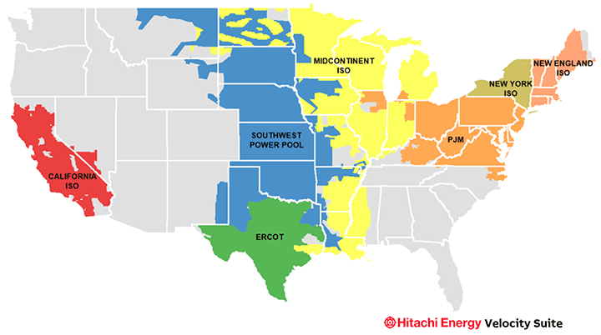
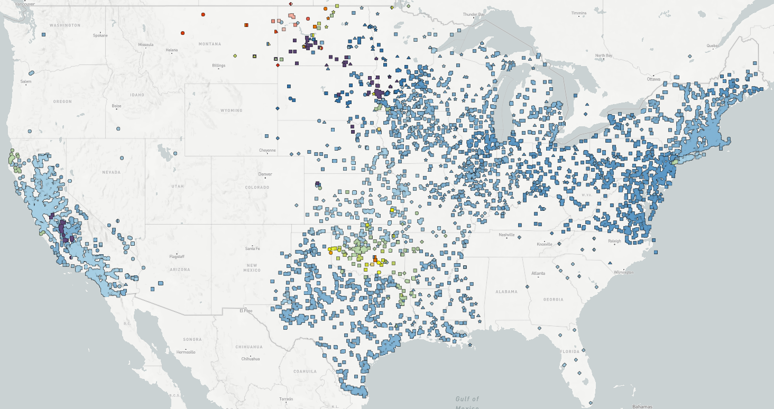
2. US Power Market Explained (cont’): A Nodal System
Centralized vs. ISO Management:
Some U.S. regions are managed by a single organization distributing power from generators to consumers (grey areas).
Other regions are handled by Independent System Operators (ISO) that ensure grid stability and manage trading activities.
Role of ISOs:
ISOs act as marketplaces covering the majority of the region’s trading activity.
There are 7 ISOs operating in the U.S.
Nodal Pricing Structure:
Within ISO regions, pricing is not uniform; instead, there are hundreds of nodes each with its own price.
Each node’s price is referred to as the Locational Marginal Price (LMP).
Importance of LMP:
LMP reflects local congestion, losses, and demand-supply imbalances, providing a granular view of electricity pricing.
This detailed pricing signal supports better market operations and targeted trading strategies.
Benefits of Decentralized Pricing:
Enhances market efficiency by aligning prices with local grid conditions.
Creates more opportunities for arbitrage and precise optimization in power trading.
Additional Insight:
The decentralized nodal system enables market participants to optimize bids based on local conditions, contributing to a more robust and transparent electricity market.

Slide 6
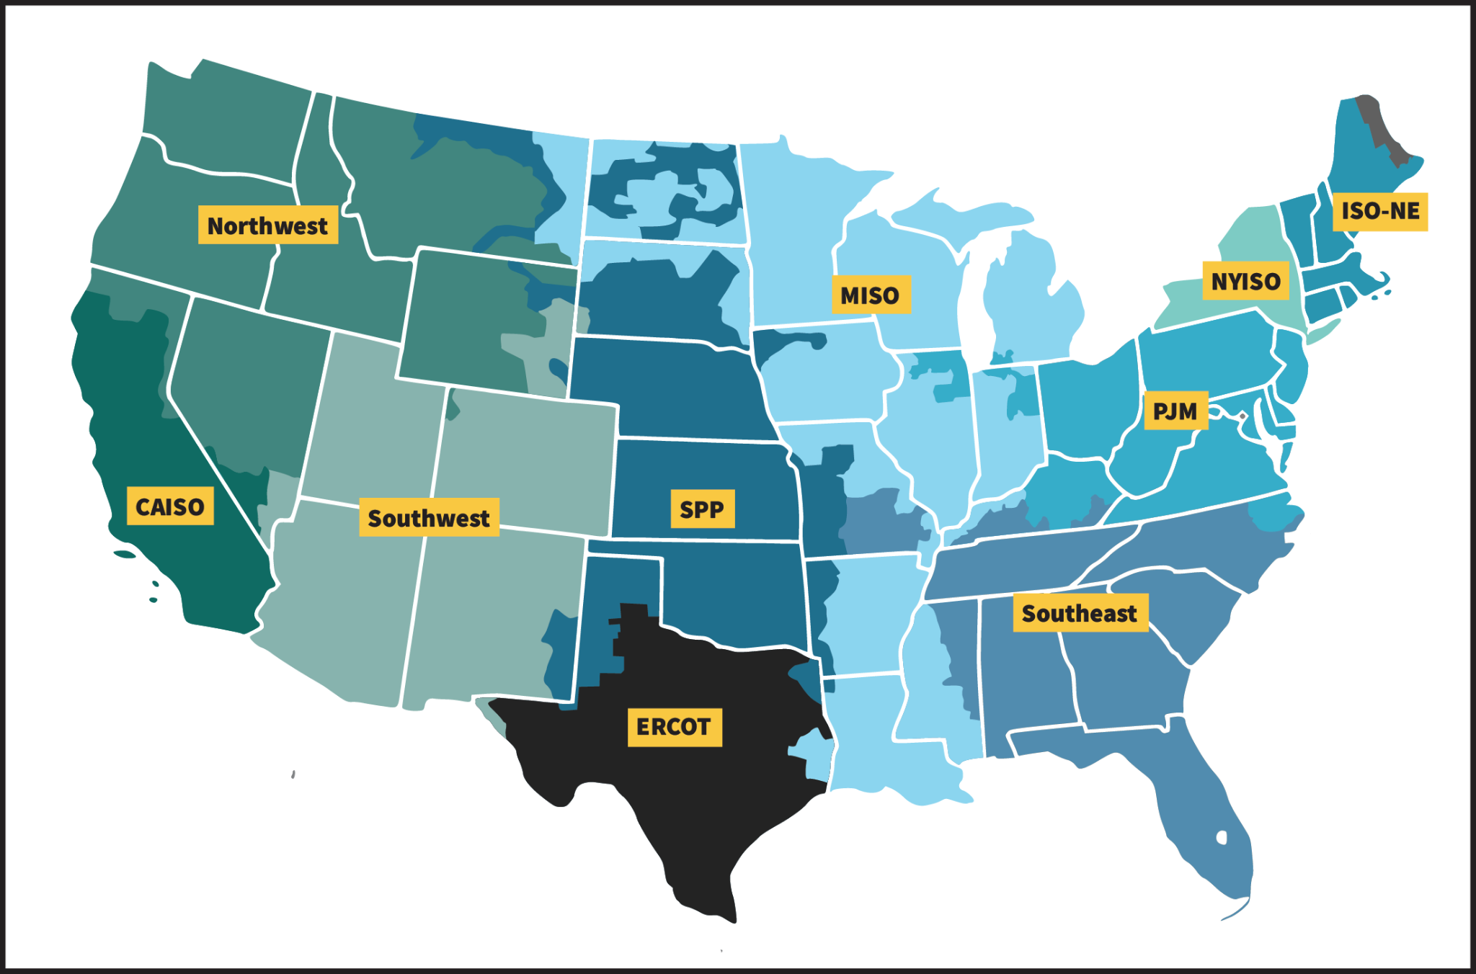
2.1 Why US Power Market
Financial-Only Trading:
U.S. power markets allow participants to trade purely financial positions without owning generation or load.
The two-settlement system (day-ahead and real-time) with virtual bidding promotes robust price discovery.
Virtual traders, making up >90% of virtual bid volume, seek profit from mispricings and help correct them, improving overall market efficiency.
Market Efficiency & Liquidity:
Increased competition and liquidity from financial players lead to a convergence of day-ahead and real-time prices.
This structure mitigates market power and ensures prices reflect true supply and demand conditions.
Nodal Pricing Advantage:
Unlike coarse zonal pricing, U.S. markets operate on a fully nodal system with thousands of prices, each reflecting local congestion and losses.
With over 12,000 nodes in U.S. ISOs compared to a dozen zones in Europe, the granularity offers more arbitrage opportunities and a richer optimization problem for traders.
Comparative Edge:
U.S. nodal design, considered more efficient by economists, provides a competitive edge by capturing localized price spreads that in Europe are often socialized via redispatch.
Notes:
[4] https://www.chesterenergyandpolicy.com/blog/virtual-bids-convergence-bids#:~:text=Virtual%20bids%20are%20financial%20instruments,Time%20market
[5] https://blog.yesenergy.com/yeblog/how-power-trading-works#:~:text=Because%20these%20trades%20are%20purely,physical%20megawatts%20across%20the%20grid
[6] https://www.researchgate.net/figure/High-level-comparison-of-the-nodal-US-style-and-zonal-EU-style-day-ahead-market_tbl2_358538938#:~:text=Contrary%20to%20liberalized%20U,redefining%20the%20existing%20bidding%20zo
[7] https://www.time2market.net/blog/a-comparison-of-european-and-american-power-markets#:~:text=In%20the%20USA%2C%20seven%20Independent,consumer%20demand

Slide 7
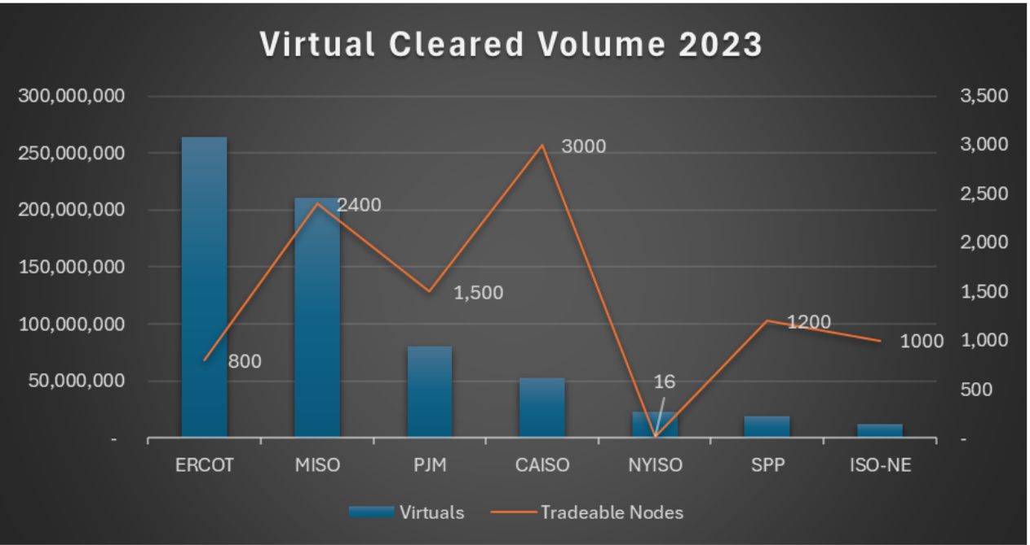
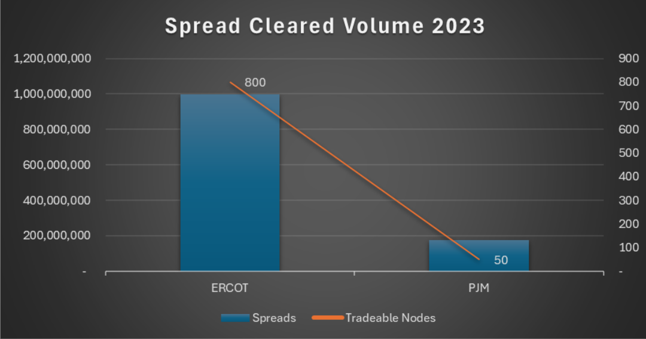
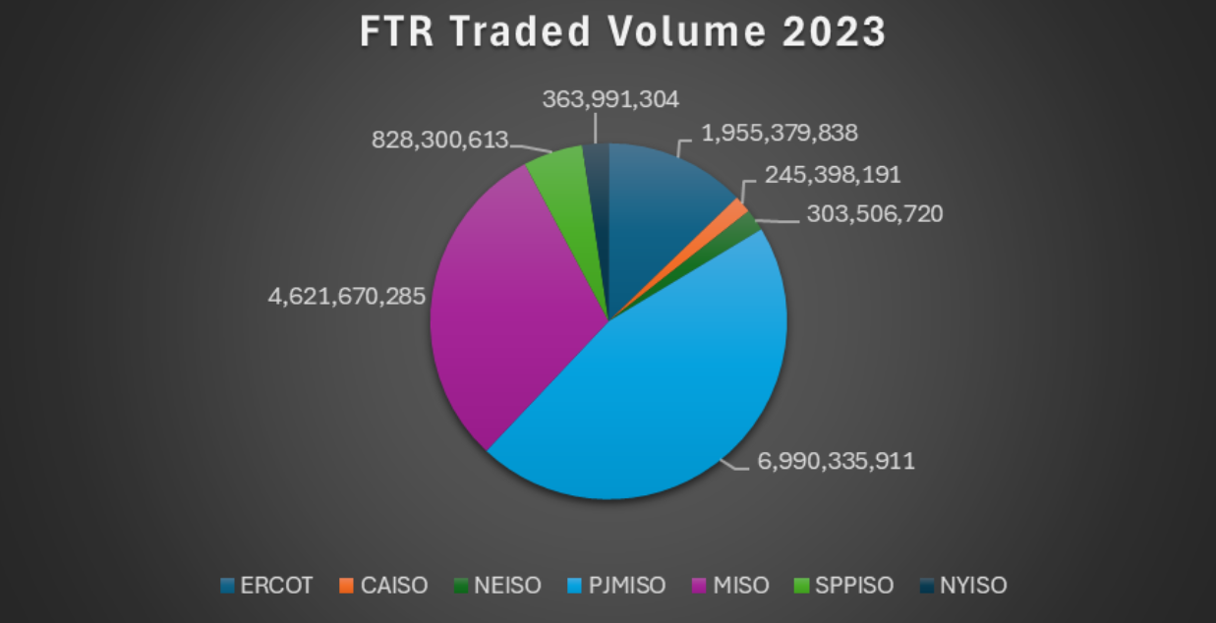
2.2 Why the Texas Power Market (ERCOT)
There are 7 ISO. One of them is called ERCOT (Electric Reliability Council of Texas).
This is the most developed and complex market. Most studies/papers are done on this market.
We will choose this one because it has the highest liquidity for financial trades (that we will describe on the next slide).
The ERCOT market is also unique in the sense that it is not connected with other regions.
In this ISO, we will study 5 main parts: Houston, North, South, West, Panhandle

Slide 8
2.3 Financial Trading and Available Products: 3 Main Markets
Futures
Day-Ahead (DA)
Real-Time (RT)
Power futures allow participants to hedge against price fluctuations by locking in electricity prices for future delivery. These contracts are traded on exchanges like CME Group (NYMEX) and ICE (Intercontinental Exchange). Futures markets provide liquidity and risk management tools for generators, utilities, and financial traders.
In the Day-Ahead market (DA), electricity is traded for delivery on the next day. Prices are determined through an auction where supply and demand bids are matched to schedule generation in advance. This market helps mitigate price volatility and provides a forecasting mechanism for grid operators and traders.
The Real-Time market (RT) operates in 5-minute or 15-minute intervals, where electricity is bought and sold to balance supply and demand in real time. Prices in this market are typically more volatile than in the day-ahead market, as they respond to unexpected demand spikes, generation outages, and renewable energy fluctuations.
Notes:
explain what futures products are and how the market works (auction?)

Slide 9
2.3 Financial Trading and Available Products (cont’): Trading
Physical traders are mostly generators (that want to sell their electricity) and load services (that buy it to distribute it after to end-consumers).
Financial traders have no interest in buying/selling electricity. Therefore, there exist financial products that allow them to participate without having to physically deliver. Here are the 3 products:
Virtuals
Spreads
FTRs
Financial products that allows you to participate/bid in the DA market for one LMP. You financially close your position on the RT market
Financial product on the spread between 2 nodes
These are financial instruments that hedge against congestion costs in the electricity grid. They allow traders to profit from differences in locational marginal pricing (LMP) across transmission nodes, providing a way to mitigate risks associated with congested transmission lines. Essentially long term options.

Slide 10
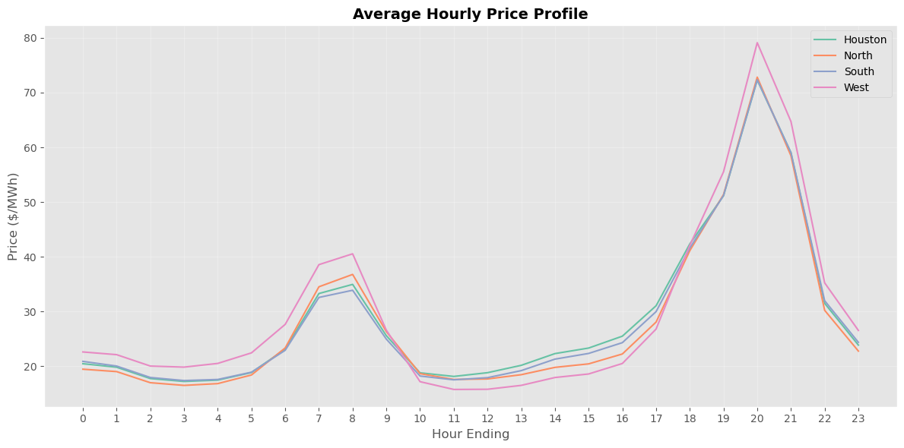
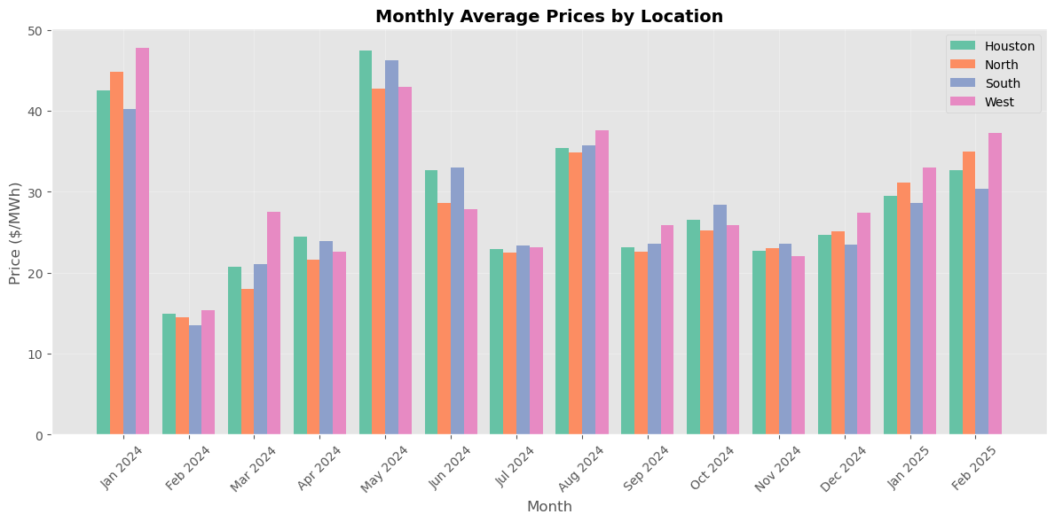
3. Exploratory Data Analysis: Price Dynamics
Data & Timeframe:
ERCOT Day-Ahead (DA) and Real-Time (RT) market data as a representative overview for the general short-term electricity market in Texas
Analysis across four hubs: Houston, North, South, West, Panhandle
Hourly & Daily Trends:
Clear diurnal patterns with distinct morning/off-peak and evening peak behaviors
Peak hours (e.g., 15–21) consistently show elevated prices
Colder months (June) as well as hotter months (May) show consistently higher trends
Descriptive Statistics & Correlations:
Average DA Prices:
Houston: $35/MWh, North: $36/MWh, South: $33/MWh, West: $37/MWh
Price volatility: Standard deviations in the range of $3–3.5/MWh
Strong pairwise correlations (≈ 0.99 between hubs) reflecting interconnectedness/efficiency of electricity transfer between hubs

Slide 11
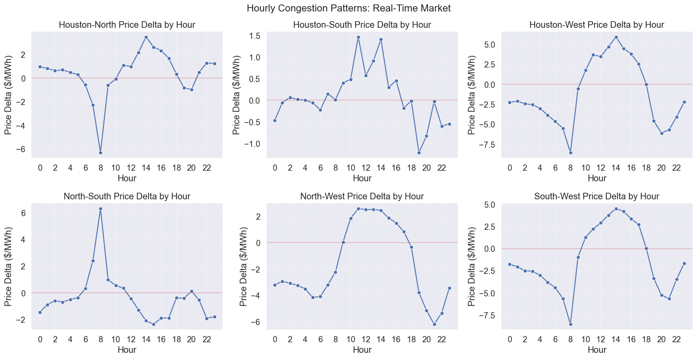
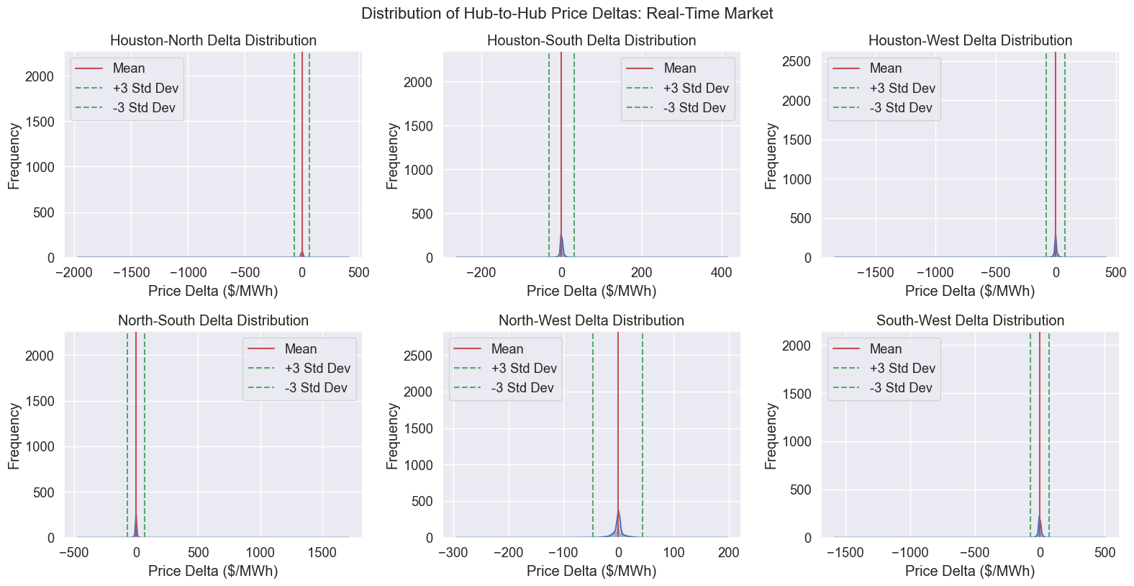
3.1 Exploratory Data Analysis: Congestion Trading
Congestion trading exploits persistent price differentials between market hubs that occur due to transmission constraints and network limitations. This creates spatial spreads of real-time prices (between nodes)
Why Including it? Congestion trading is a common trading strategy in US power market because of the high volatility of spatial spreads that create large opportunities if able to forecast.
Node prices spreads in ERCOT: We plot the hourly average spreads between nodes as well as the empirical distribution and see that on average spreads are very close to zero, but exhibits high volatility.

Slide 12
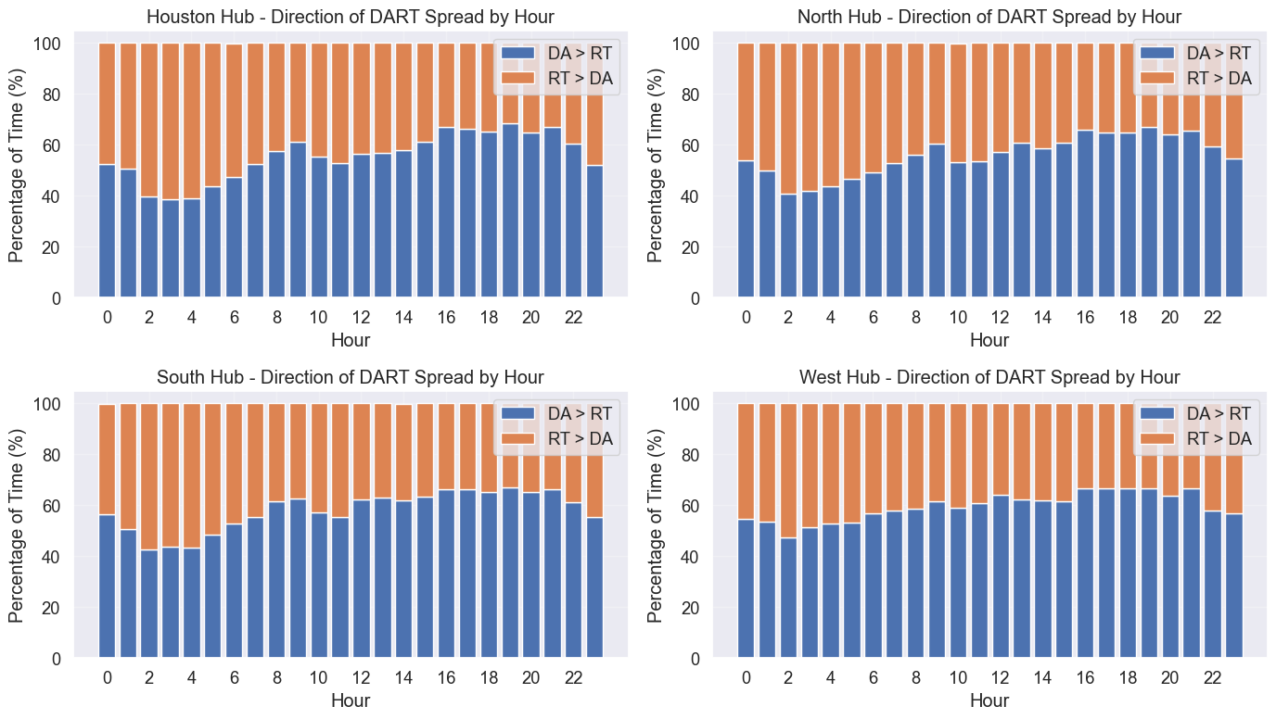
3.2 Exploratory Data Analysis: DART Strategy
DART spread trading captures the difference between Day-Ahead (DA) and Real-Time (RT) market prices to exploit market inefficiencies. Why It’s Included: The time spreads is due to last-moment forecasting errors (in production and demand). The main reason for those forecasting errors is the weather
Methods & Analysis:
Data Alignment & Spread Calculation: Merge DA and RT data by delivery date and hour to compute the DART spread
Time-of-Day Analysis: Compute hourly statistics to determine the probability and expected value of positive versus negative spreads
Seasonal and Day-type Effects: Compare monthly patterns and weekend vs. weekday differences to identify consistent opportunities

Slide 13
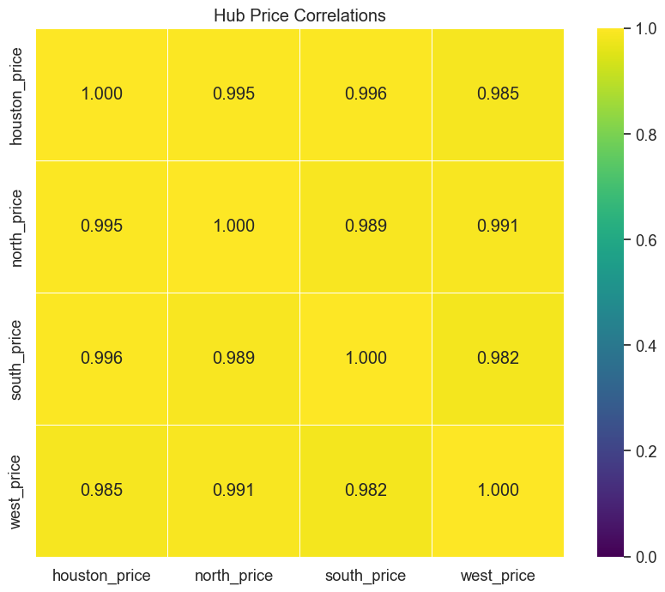
3.3 Exploratory Data Analysis: Inter-Hub Relationships
Inter-hub relationship trading leverages dynamic correlations, lead-lag effects, and temporal shifts among different market hubs to forecast price movements. Why It’s Included: It is included because understanding these interdependencies adds diversification to trading signals and helps optimize trade timing.
Methods & Analysis:
Correlation Analysis: Calculate baseline correlation matrices and visualize co-movements using heat maps
Lead-Lag Dynamics: Analyze lagged price series with cross-correlation techniques to identify predictive time lags
Temporal Correlation Shifts: Monitor deviations from baseline correlations by hour, month, and day type
Integrated Relationship Trading: Combine multiple metrics (correlation strength, lead times, event detection) to score and prioritize trading opportunities

Slide 14
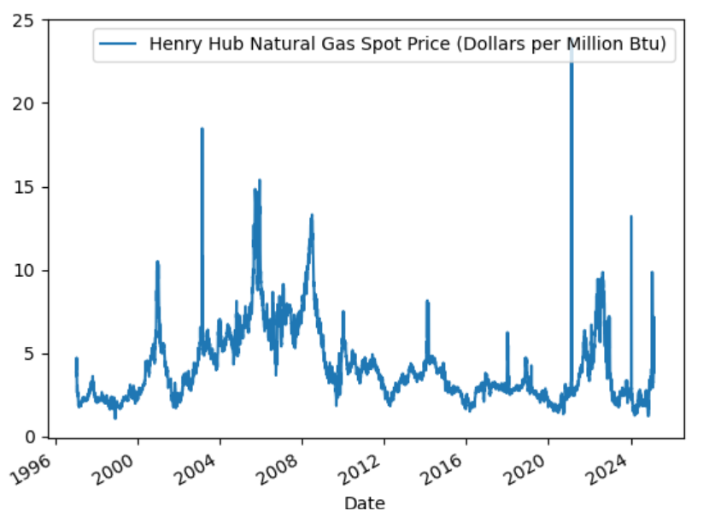
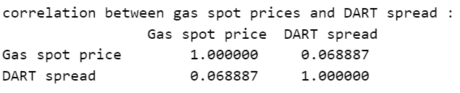
3.4 Exploratory Data Analysis: Gas Prices
Gas prices can influence LMPs as a part of the total production comes from gas turbines, who are dependent on the gas price. Therefore, the cost of production of those plants depend on the gas price. We may want to check if it has some impact on the DART spread
We will use the Henry hub spot price as it represent the spot price of the gas in the pipelines entering in texas
We see that there is no linear relationship between the DART spread and the gas price. We will see later, if combined with other feature, it helps explain the DART spread

Slide 15
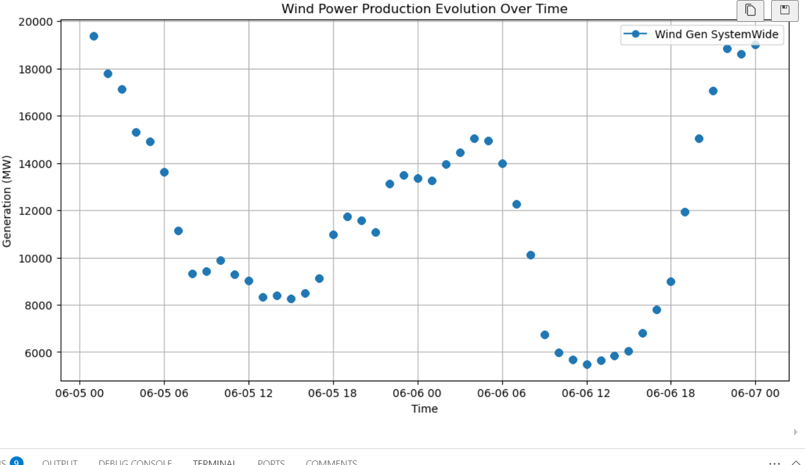
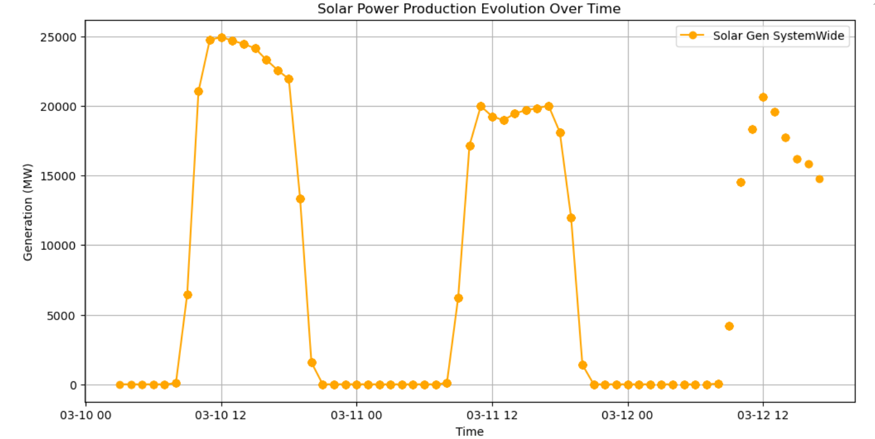
3.5 Exploratory Data Analysis: Wind & Solar
Renewable energies have a big impact on LMPs, and also on DART spread. Indeed, being difficult to forecast precisely their production, their unpredicted variability causes imbalance on the grid (leading to spikes).
We will use available forecast data through ERCOT API.
We can clearly on the graphs the daily seasonality of the solar and wind production

Slide 16
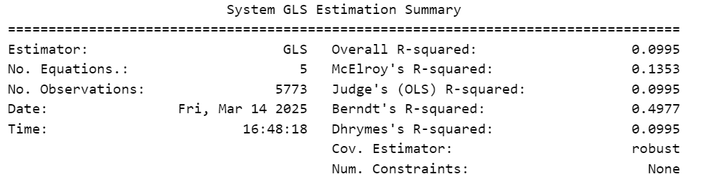
3.6 Exploratory Data Analysis: Inference
In order to check the impact of predictors on the DART spread, we conduct a causal inference regression. This means that the output (dart spread) and the predictors are measured at the same date. This helps to understand the relationship.
For the prediction we will replace the realised values for predictors by the forecasted values
We run multi-variate regression of the 5 outputs (DART spread for the 5 regions in Texas) with the predictors and obtain this summary
We see a low R-squared meaning the dependence is not linear. However most predictors are statistically significant (low p-value)
Therefore , we can keep those variables but we should
change the model

Slide 17
4. Trading Strategies in Power Markets: An Overview
DART (day ahead vs real time) Trading strategy:
How does it work? For a specific node with an associated LMP, you submit a bid/ask on the DA market (i.e you pay/receive a fixed price) and close the position ‘financially’ on the RT market (i.e whatever you bought/sold in the DA market needs to be sold/bought back on the RT market at a float price).
How to make profit? You speculate on the ‘temporal’ spread between the DA and the RT market, and participate accordingly (i.e if you think the price is going to rise, buy in the DA market)
Which product to use? Virtuals
This is what we will study
Congestion Trading strategy:
Context? There are transmissions between nodes to equilibrate prices, but sometimes the amount of electricity is to high to balance prices: this is called congestion. One can speculate on it.
How to make profit? Analyze historical nodal LMP data to identify with frequent congestion and price disparities. Look for recruiting patterns that cause congestion. Using forecast: Buy electricity at a lower-priced node and sell it at a higher-priced node when congestion occurs
Which product to use? Spreads (Point-to-Point)
We are not able to study that (too complex)

Slide 18
4.1 Factors
For the trading strategies, we need factors that have predictable power (and not only explanatory power in inference). We can decompose the the factors in 3 categories:
Forward-Looking (forecast data for the next day) | Seasonal (data that helps explaining the seasonality of market prices and spread) | Backward-Looking
Weather Load Gas price | Hour of the day Day of the Week Month | Past prices Past spikes Past errors

Slide 19
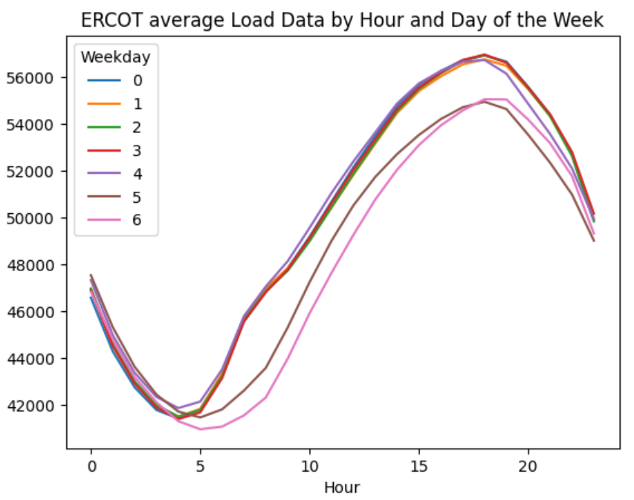
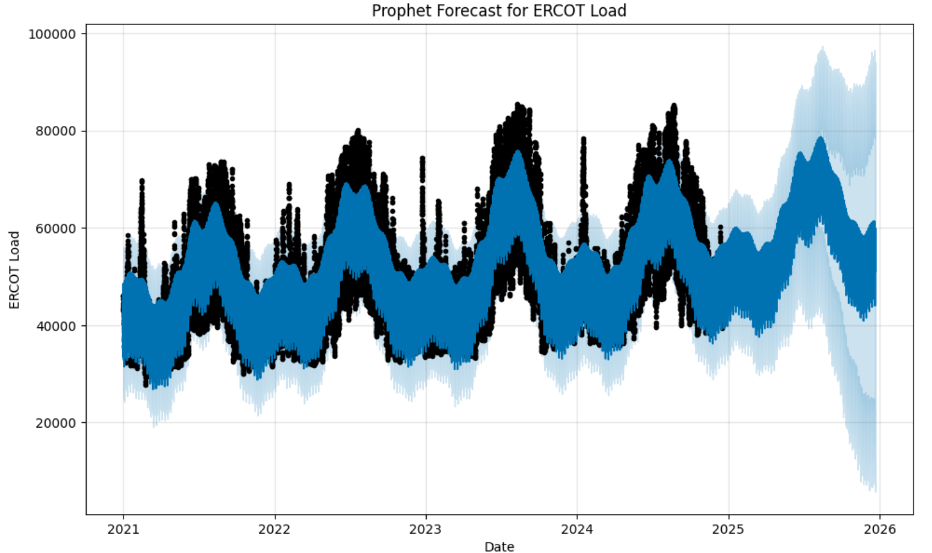
4.2 Forecast Models
As previously mentioned, we need forward-looking data for weather, gas price and load. Spot gas price already give the next day price for gas, and the weather forecast is provided by ERCOT.
For the load data, we see a clear trend and auto-correlation of data. To create our forecast values, we create one a week the forecasted values for the next week using all the available data. We use Prophet library

Slide 20
4.3 DART Premium
When calculating the mean value for DART spread, we observe a positive for all nodes: this is called the DART premium. This a premium the trader collects for taking the risk of the real time volatility (spikes).
Therefore, it is quite similar to a fx carry trade strategy: positive mean return but large downside beta (fat left tail)
We also notice on the table below that the higher the risk is (measured here by standard deviation), the higher the mean return is.
This observation leads to the following strategy: Instead of always going long the spread, we forecast negative spike to go short or to decide not to trade at this moment.

Slide 21
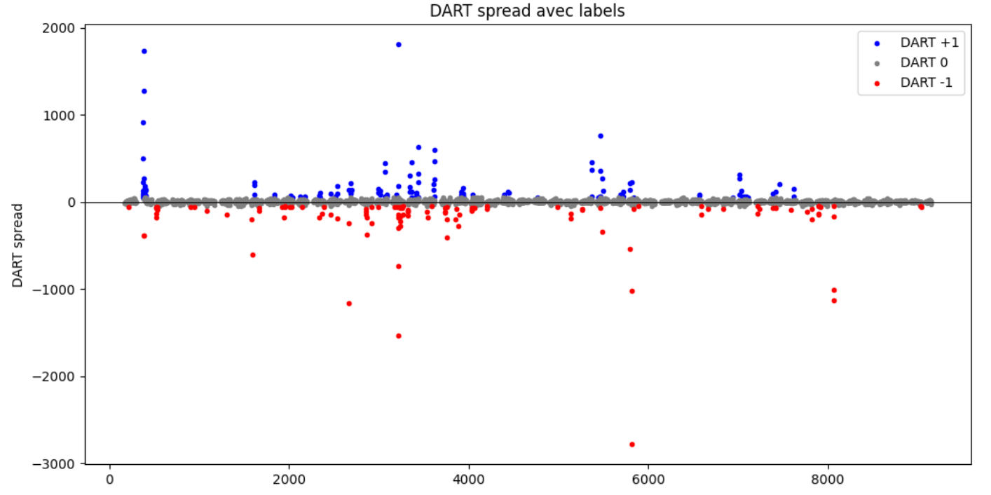
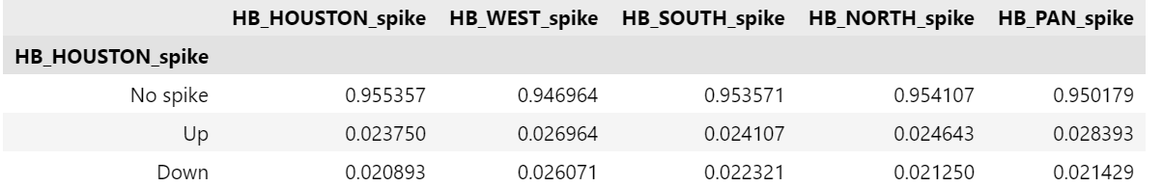
4.4 Spike Forecasts
We define a positive spike as a spread>50 (that we label as 1) and a negative spike as a spread<-50 (label -1), else no spike (label 0).
Also, labels are very imbalance which leads to over-prediction of no spikes (to correct it we duplicate data to balance labels)
We decided to use a
multinomial logistic
regression model

Slide 22
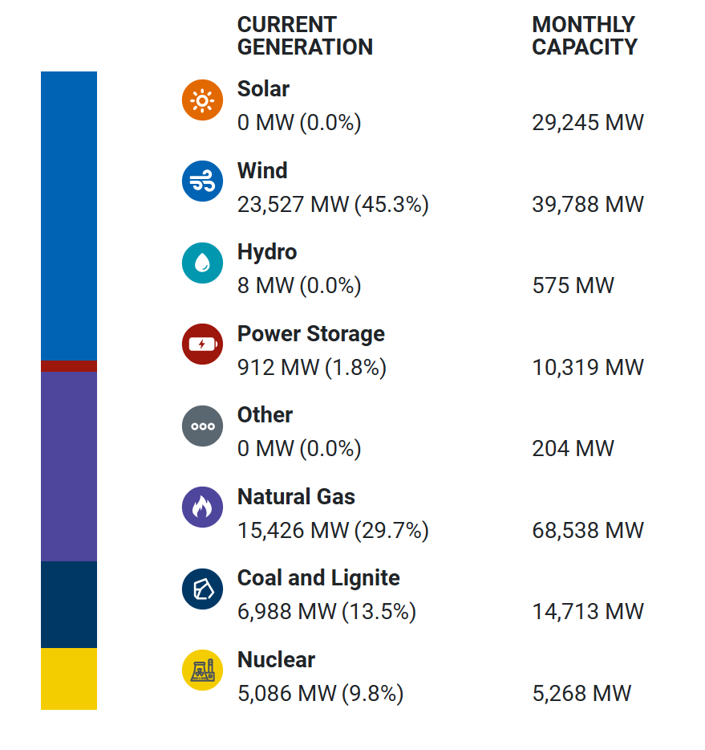
Market Influences on Price and Signals
Weather
Weather Impacts (Temperature & Renewables): Extreme temperatures drive surges in electricity demand for heating or cooling, often causing price spikes​. On a scorching summer day, ERCOT load can double due to air conditioning, leading DA prices to underpredict RT scarcity. Conversely, milder weather can soften demand and prices. Weather also affects supply: wind and solar generation swings (due to weather conditions) create large price volatility. Surplus wind during gusty nights can push prices to zero or negative, whereas sudden drops in wind/solar output spur scarcity pricing​. Our trading signals monitor forecasted vs actual weather; unexpected heat waves or a lull in wind can indicate a likely RT price jump above the DA price, triggering a long (buy DA, sell RT) position.
Natural Gas
Gas-fired generators often set the marginal price in ERCOT, so fuel cost is a strong baseline for power prices. “Price changes for natural gas have an outsized influence on wholesale electricity prices because natural gas tends to set the marginal price during most hours”​. Our signals incorporate natural gas price trends (and shocks) – for example, a sudden rise in gas price after the day-ahead market could make real-time electricity more expensive than anticipated in DA. In such cases, the strategy would go long DA (locking in the lower price) expecting to profit when RT reflects the higher gas-influenced price. Similarly, a drop in gas price can cause DA to overshoot, prompting a short DA position. By integrating fuel cost data, the model adapts to fundamental cost shifts that drive the DA vs RT spread.
Load
Load is a primary determinant of price – higher demand tightens the supply balance and raises LMPs. ERCOT’s day-ahead market bases prices on forecasted load. If real-time demand exceeds the forecast (e.g. due to an unpredicted weather surge or error in the load forecast), real-time prices will spike above day-ahead prices. Our strategy capitalizes on these discrepancies by using ERCOT’s load forecasts and real-time demand data as inputs. When our model sees a likely demand underestimation in DA, it generates a buy signal in DA expecting RT prices to settle higher. In essence, load forecast errors translate directly into DART trading opportunities.

Slide 23
5. Conclusionary Findings
Implementation of Naïve Strategy
Implementation DART strategy using spike forecasts
Future Improvements

Slide 24
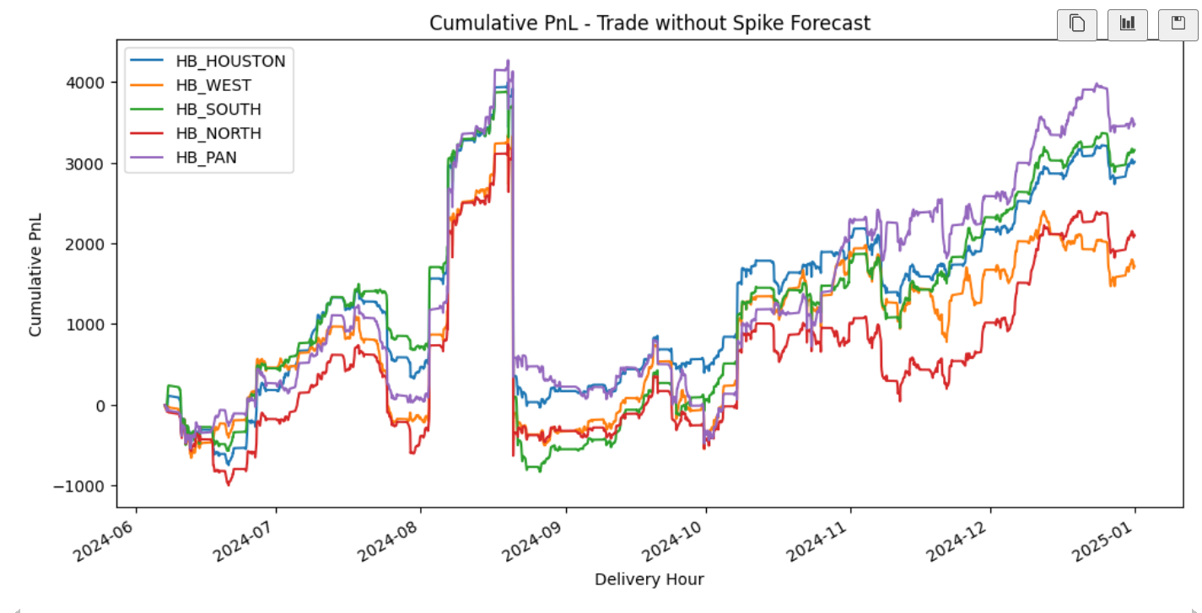
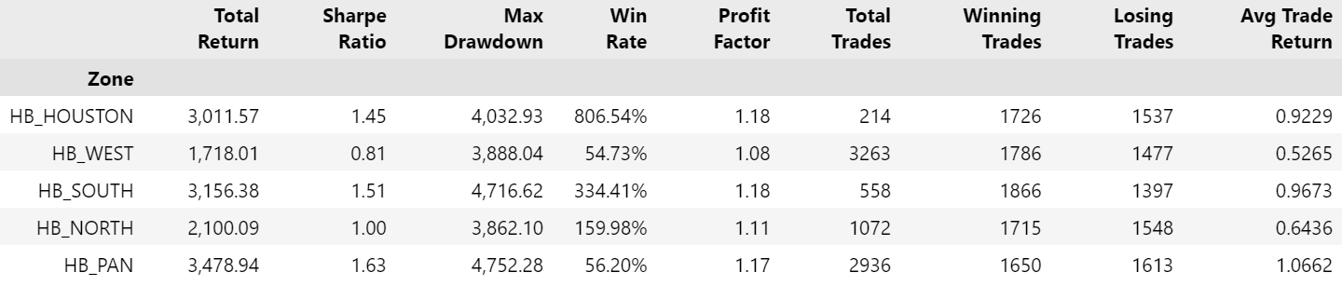
5.1 Implementation of trading strategies: Naive
The naive method is always going long the spread (buying the da and selling the rt). We use DART premium
This leads to high volatility of our strategy
We trade from June 2024 to the end of 2024 (we will use the first half of the year as a training set later)

Slide 25
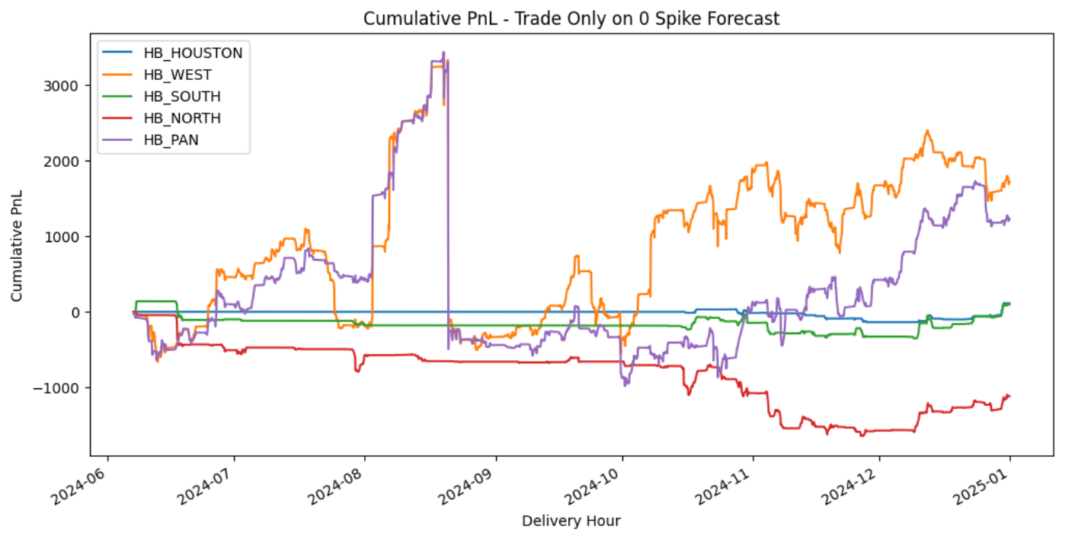
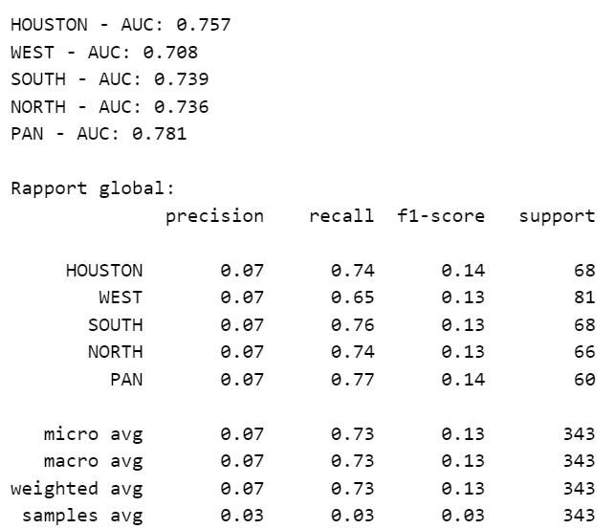
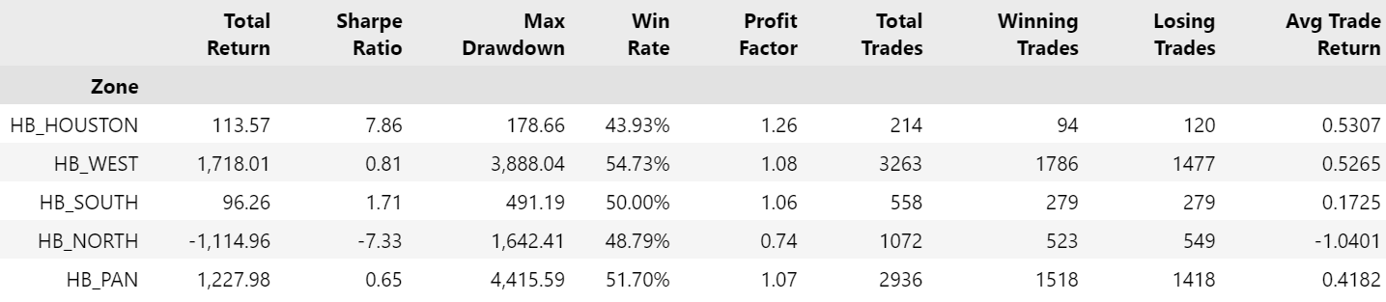
5.2 Implementation of trading strategies: With spike forecasts
We try to keep the DART premium while avoiding the negative spikes (also try short those)
We see that our forecast model is not performing well, leading worst performance (poor performance in foreasting negative spikes)
However we did manage to reduce risk (max drawdown) and able to achieve very high SR for some nodes (Houston).

Slide 26
5.3 Future Improvements
The most important part is trying to improve spike forecasts. To do so:
Add features (such as temperature data)
try to better balance labels, try/finetune ML classifiers, add past errors data
Find more historical data (more than 1 year)
Add sizes to our trades (because four now we only buy the same number of units each trade). They could be related to the spikes model forecast confidence level for exemple.

Slide 27
Appendix
Sources of data:
ERCOT data: https://www.ercot.com/services/mdt/data-portal
Gas data: https://www.eia.gov/opendata/
Weather data: https://data.nrel.gov/
Source of information: Modo Energy and Yes Energy are very useful
Papers:
Energy trading efficiency in ERCOT’s day-ahead and real-time electricity markets, Jay Zarnikau

Slide 28
About the notebooks
There are many notebooks corresponding to different steps of the project. Here is the explanation
trading_strategy_with_ML: implements the sophisticated strategy with spike forecasts
Naive_DART: implements the naive trading strategy without spike forecasts
Inference_lmp_predictors: see the causality between lmp/dart spreads and the predictors
Natural_gas: download and analyse data on gas from henry hub (more than just spot)
Weather_ERCOT: download and store wind and solar data in 2024 from ERCOT website + analysis
utils: some function to use the ERCOT API
Load_forecast: analyze load time series and implement the forecast model

